Slide 1
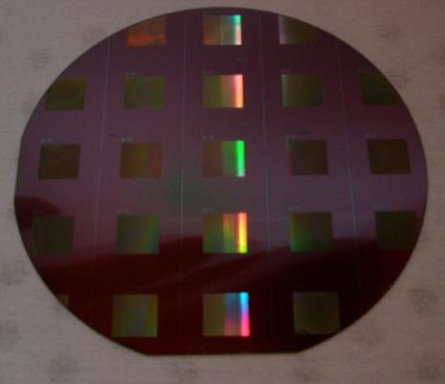
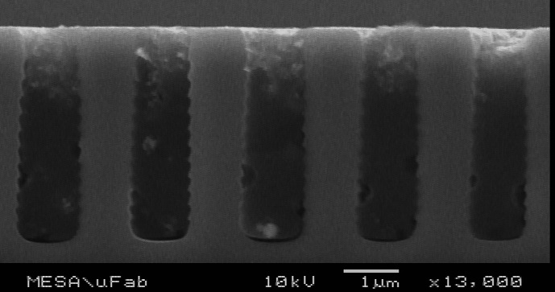
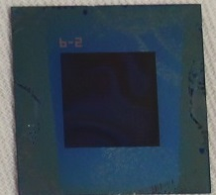




Polarization for Remote Chemical Detection
d
Control
Device
Julia Craven Jones - jcjone@sandia.gov
Polarization Techniques & Technology – 24 Mar 2014

Slide 2
Acknowledgements
SNL Technical Team: Leah Appelhans, Eric Couphos, Todd Embree, Patrick Finnegan, David Karelitz, Charles LaCasse, Ting Luk, Adoum Mahamat, Lee Massey, Anthony Tanbakuchi, Steven Vigil, Cody Washburn
Collaborators: Dennis Goldstein, Polaris Sensor Technologies
This work has been funded by DOE-NNSA/NA221, Victoria Franques, Program Manager.

Slide 3
Outline
Motivation
Approach
  Dosimeter Tag Development
  Dosimeter Tag Testing and Characterization
Results
  Exposure Results
  Tag Sensitivity, Selectivity, and Optimization
Conclusions and Future Work

Slide 4
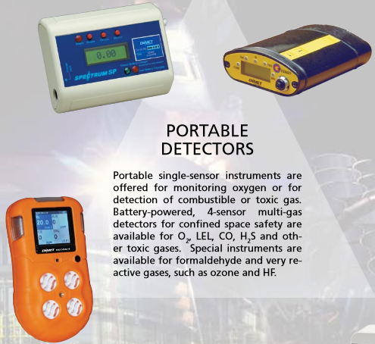
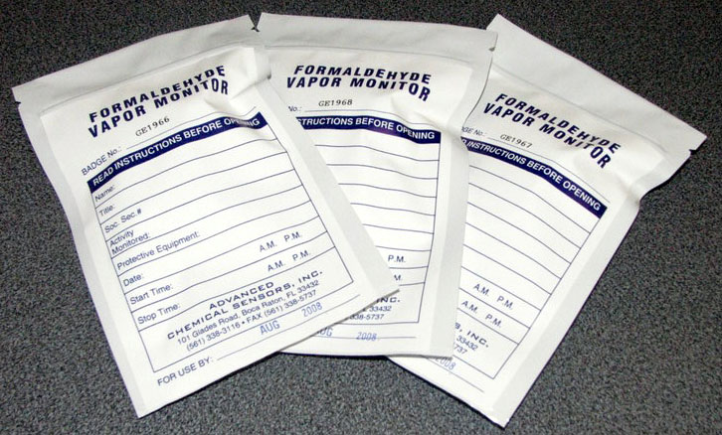
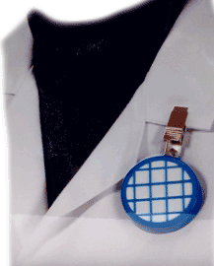
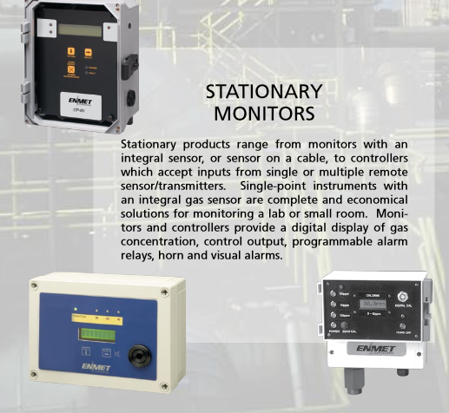
Motivation
There is a need for persistent, passive, and non-invasive monitoring systems for detecting hazardous chemical vapors.
Hydrogen fluoride (HF) gas monitoring is the particular focus of this work.
  HF is the principal industrial source of fluorine.
www.enmet.com
www.acsbadge.com
www.kemmed.com
www.enmet.com

Slide 5


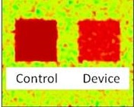
Approach
Develop HF-sensitive dosimeter tags that can be used to monitor a facility for a period of weeks to months.
d
Ambient Atmosphere
Illumination
HF Tag
Control
Device
Polarimeter
Processing & Display

Slide 6
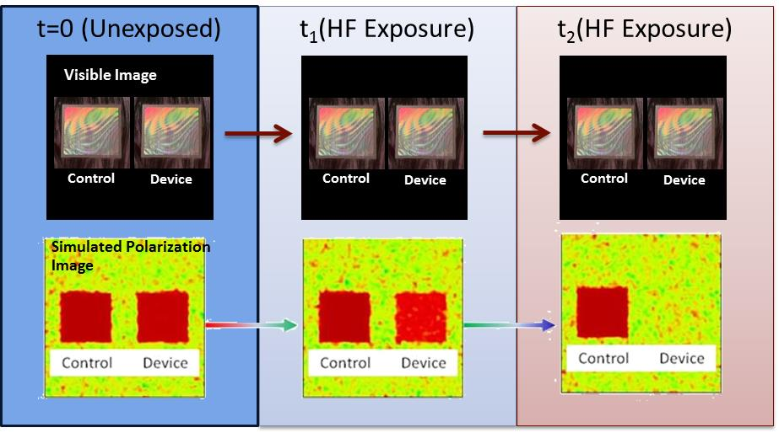
Approach
Monitoring mechanism: optical polarization properties of the tags change upon exposure to HF (~1-3 ppm for 30+ days).
Low Impact & Passive
Measurement
Persistent Monitoring Capability
Simplified Data Products

Slide 7
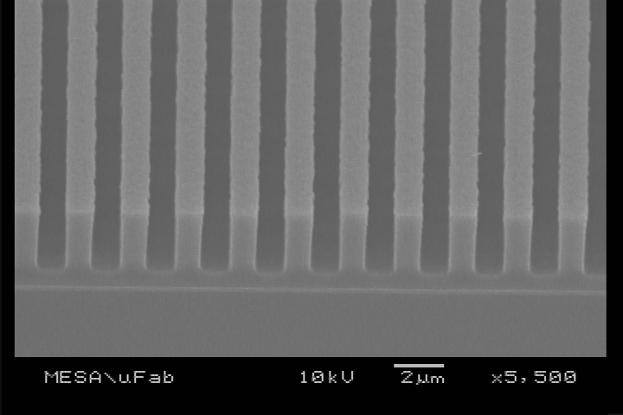
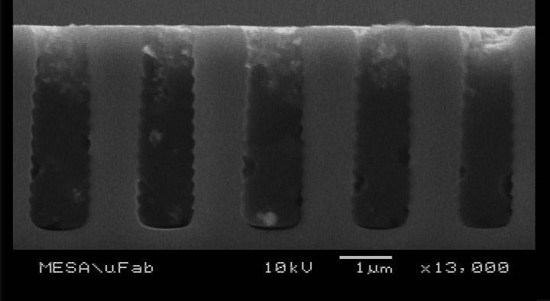
Dosimeter Tag Production
Standard lithographic approach used for dosimeter tag production.
  2.3 µm periodic structure etched in silicon forms tag substrate.
  Substrate is coated with HF-sensitive material.

Slide 8
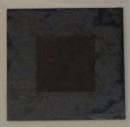
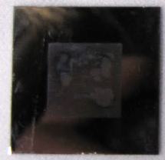
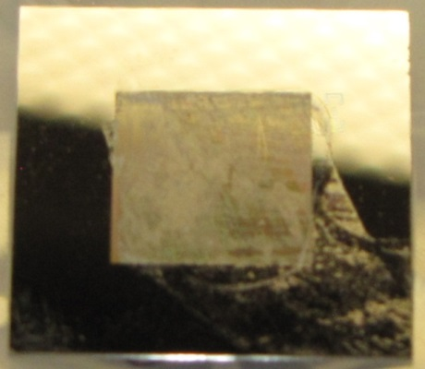
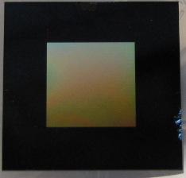
Tag Development
Many tag fabrication approaches investigated:
  Polymer roll coated
  Polymer polished
  Ti-Isoproproxide coated
  Ti evaporative deposition
  TiO₂ evaporative deposition
Tested all fabrication approaches developed at 30 ppm for 24 hours and ~35% RH.
  Tags coated with TiO₂ produced largest polarization change.
Polymer Roll Coated
Polymer Polished
Ti-Iso Coated
TiO2 Coated

Slide 9
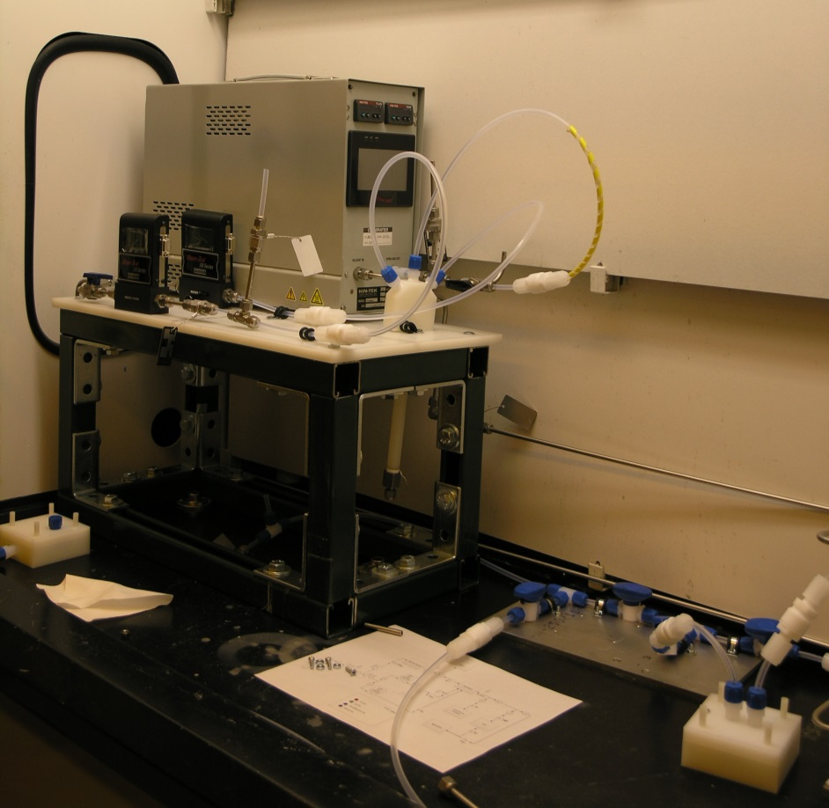
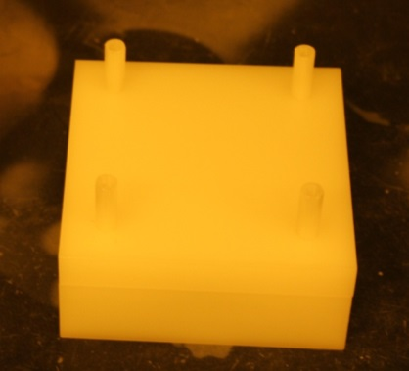
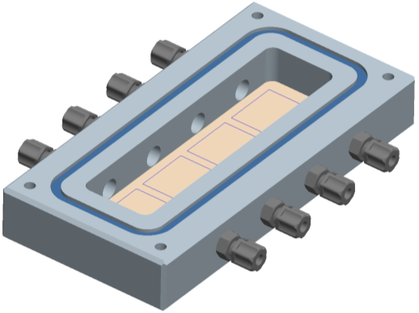
Simulating Tag Exposure
Developed low concentration HF exposure system to mimic facility exposure conditions.
  HF vapor exposure, 1-30 ppm.
  Lab room temperature (~22 C).
  Variable humidity (~30%)
1-8 samples per exposure
Single Channel DUT
Multi- Channel DUT

Slide 10
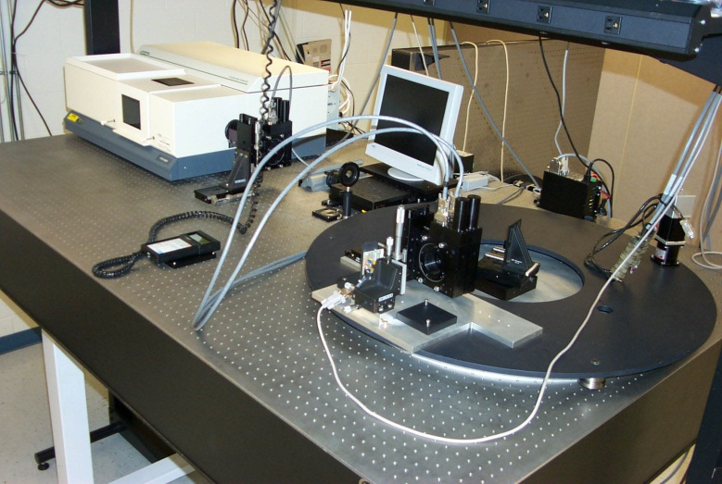
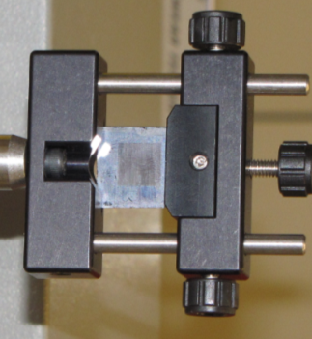
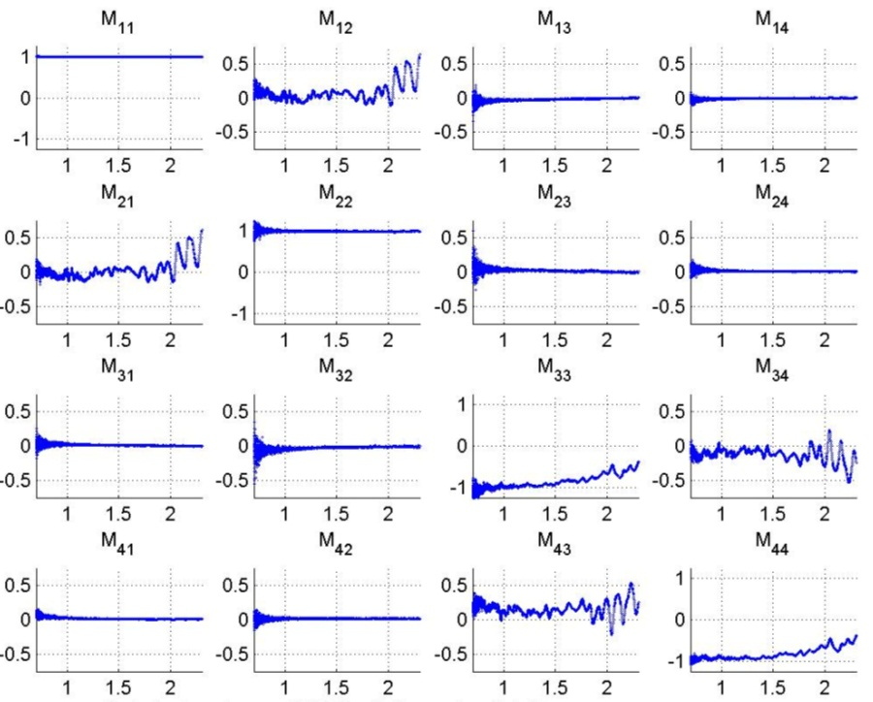
Mueller Matrix Tag Characterization
Polaris MM Polarimeter
Spectropolarimetric Mueller matrix (MM) measurements of the tags accomplished through a measurement partnership with Polaris Sensor Technologies.
  Full polarimetric characterization over λ=0.7-2.3 µm and λ=4.0-12.0 µm.
  NIR, SWIR and LWIR of primary interest due to the availability of COTS uncooled detectors.
Mueller Matrix Data
FOURIER TRANSFORM SPECTROMETER
PSG
SAMPLE
BS
PSA
DETECTOR
ASSEMBLY

Slide 11

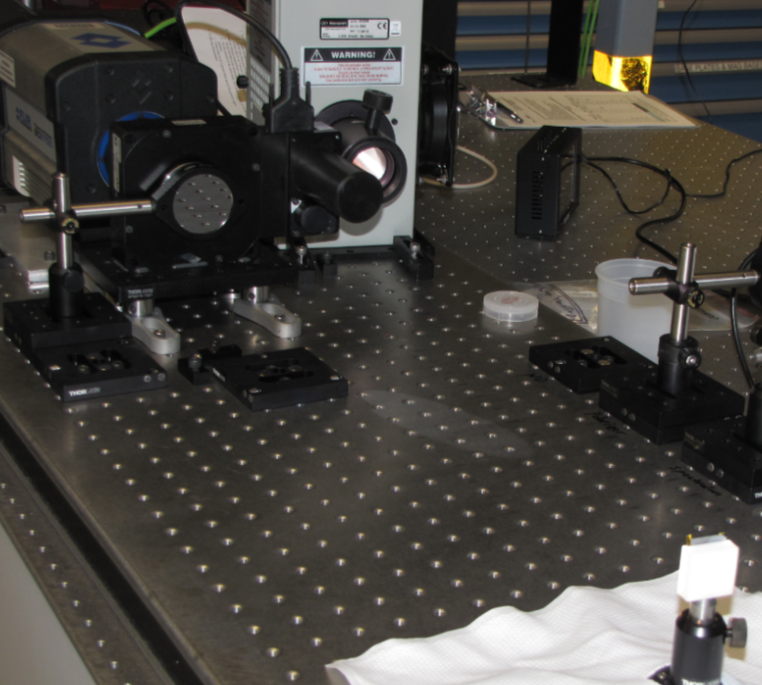
SWIR Linear Stokes Polarimeter
Rotating polarizer polarimeter characterizes the degree of linear polarization (DOLP) reflected off the tags in the SWIR.
  QTH 50 W collimated light source.
  100 nm spectral filters centered at λ = 2.14, 2.20, and 2.36 μm.
  FLIR InSb imaging camera with 50 mm objective.
QTH
lamp
QTH
Mounted Tag
DUT
InSb camera
+ spectral filters
Polarimeter
A
G
ND
A: Analyzer ND: OD2 filter
G: Generator (removed for tag and offset measurements)
0.75 m
DUT

Slide 12
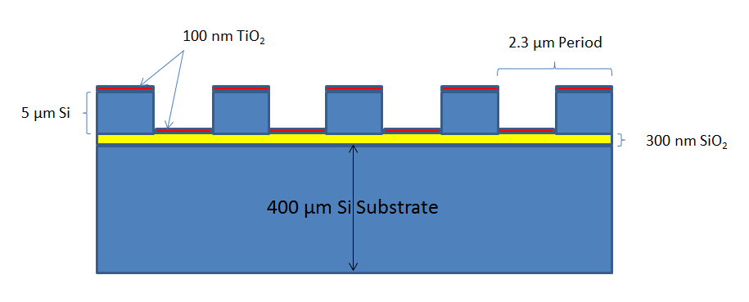
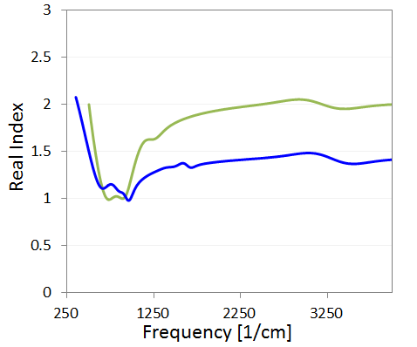
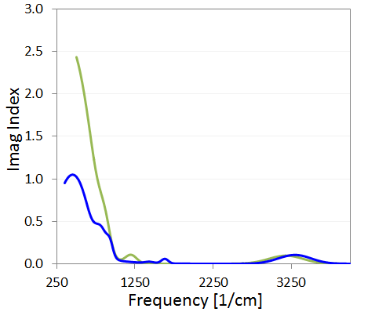
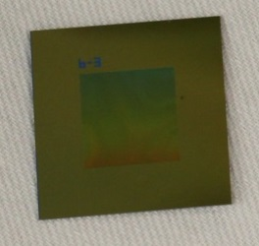
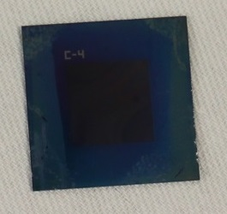
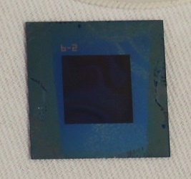
Optimizing Tag Production
Material behavior before and after HF exposure is being characterized using several techniques.
  Ellipsometry
  X-Ray Diffraction, Raman Spectroscopy
  Interferometry, AFM
Amorphous TiO2 is most sensitive to HF
  Thickness variation being modeled and tested.
  Lower bound of sensitivity currently >1 ppm for 30 days.
Selectivity experiments being conducted.
  Tests with other acid vapors (HCl and HNO₃) indicate little to no change in polarization state.
unexposed
exposed
exposed

Slide 13
Tag Sensitivity Results
30 ppm exposure for 24 hours, ~25% RH
Unexposed
Unexposed DOLP =
0.16
0.05
0.29

Slide 14
Tag Sensitivity Results
30 ppm exposure for 24 hours, ~25% RH
Exposed
Latest results: 4/5 tags tested had a ΔDOLP >= 0.04 at λ = 2.14 μm
Exposed DOLP =
0.27
ΔDOLP = 0.11
0.09
ΔDOLP = 0.04
0.27
ΔDOLP = -0.02

Slide 15
Tag Sensitivity Results
Change in DOLP map, exposed vs. unexposed
Exposed DOLP =
DOLP_{unexp}
0.27
ΔDOLP = 0.11
DOLP_{exp}
0.09
ΔDOLP = 0.04
ΔDOLP
0.27
ΔDOLP = -0.02

Slide 16
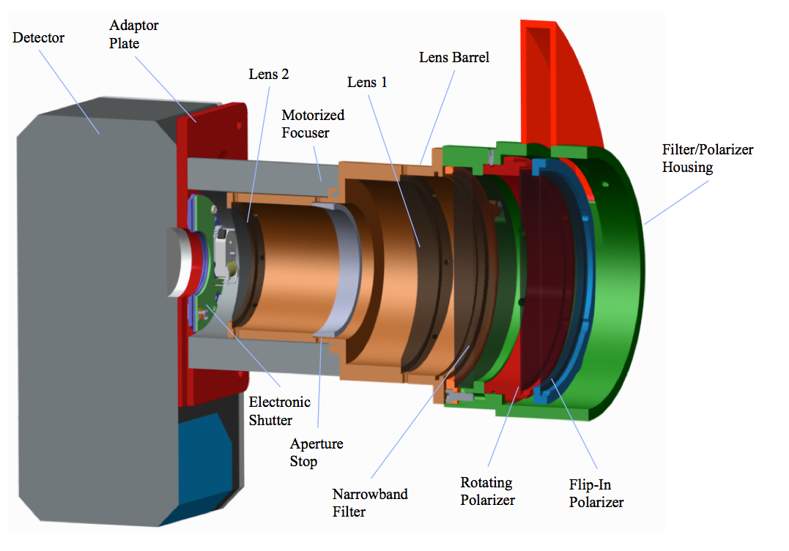
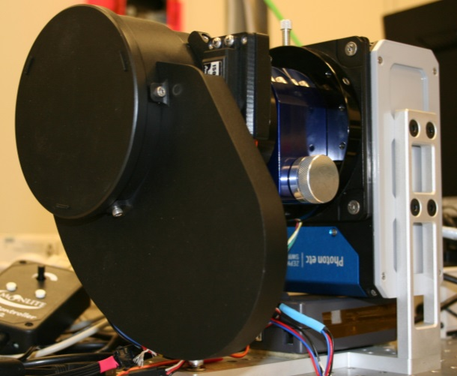
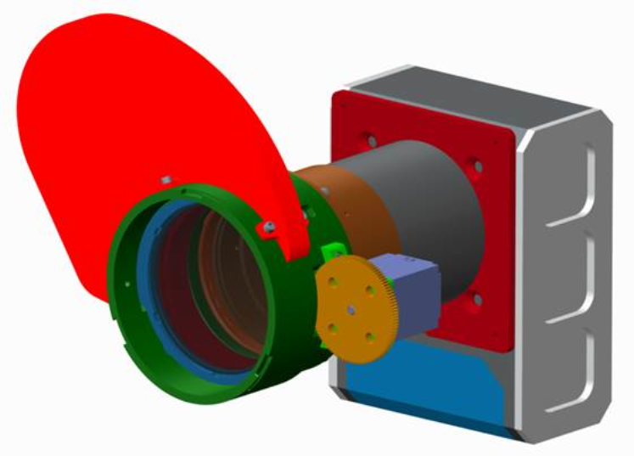
Polarimeter Prototype
SWIR (λ=2.1 – 2.4 µm) imaging polarimeter can be used to interrogate the dosimeter tags.
  Straightforward data products and processing, field portable, simple automated operation.
  Polarimeter is assembled and is currently being tested at SNL.

Slide 17
Conclusions and Future Work
This effort demonstrates a polarimetric approach to monitoring for gases.
  Passive and persistent monitoring using an unconventional approach.
  Tags are simple and small and could be installed nearly anywhere.
  HF monitoring is the focus of this project, but could modify general approach for detecting other chemicals of interest.
Future work will be focused on further optimization of the dosimeter tags and testing of the complete monitoring system.

Slide 18
End
Thank you!

